Slide 1
Tic Tac Toe 3D

Slide 2
Team Information
Team Name: 76
Members:
Grant Hruzek ( Team Lead)
Ethan Wright
Chris Padilla
Taylor Incorvia

Slide 3
Problem Statement and Significance
The purpose of this project was to develop and further improve on our version of a 3-dimensional 4x4x4 game of tic-tac-toe and thoroughly test its functionality as an application making the necessary improvements provided by our peers.

Slide 4
Restrictions and Limitations
Memory issues
Suboptimal AI
Windows Form Limitations

Slide 5
Overall Development Approach
Completed in several Agile sprints with several meetings per week
Divide and Conquer – Divided up the functionality and each worked on our respective parts.
Designed the back-end code base to be highly portable and streamlined, allowing us to port the Java backend to C# in a matter of minutes.
Entire AI functionality is one method call, made it easy to integrate with the new C# GUI
Windows Forms abstracted the code for the GUI elements so the developers could focus more on the overall design and game flow rather than technical details (this can also have its downsides).

Slide 6
Results, Analysis, Design Changes, Difficulties and Solutions
Results
Fully working 3D Tic-Tac-Toe game, delivered in an easy to use and visually pleasing GUI environment, with the improvements integrated as suggested by our users.
Analysis
We had a group of diverse non Computer Science students analyze the initial JavaFX implementation. We used their feedback to improve our C# iteration.
Design Changes
The game flow and GUI elements were slightly altered to improve navigability and visibility.
(I.E. entering user initials, and improving player/AI piece visibility)
Difficulties
Lack of CSS and transparency support
Implementing smooth transitions
Solutions
Divided the tasks and conquered them separately, while making conscious design compromises
(sacrificing a design with better visual aesthetic (GUI-1) for a design that had better visibility (GUI-2))

Slide 7
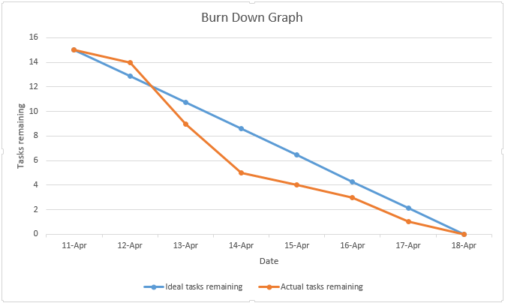
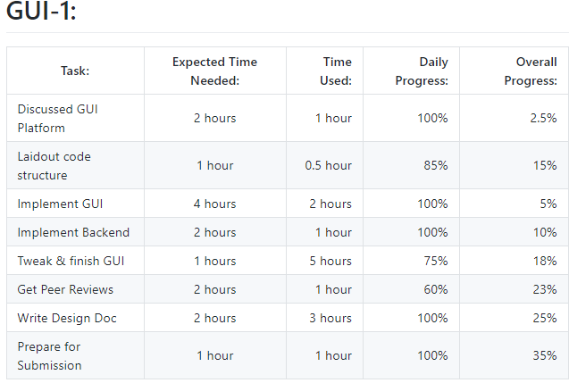
Burn Down Graph of GUI1

Slide 8
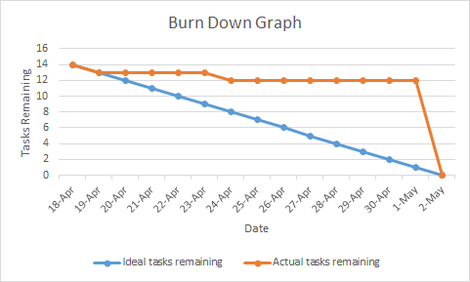
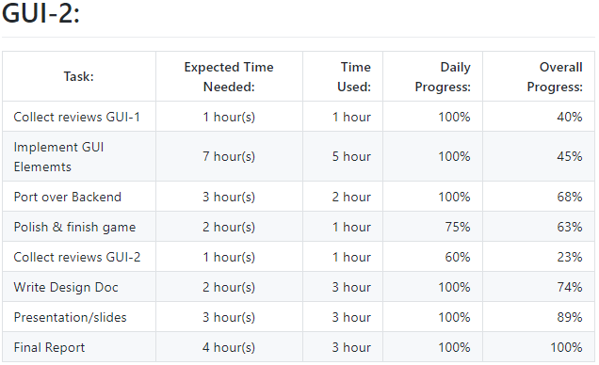
Burn Down Graph of GUI2

Slide 9
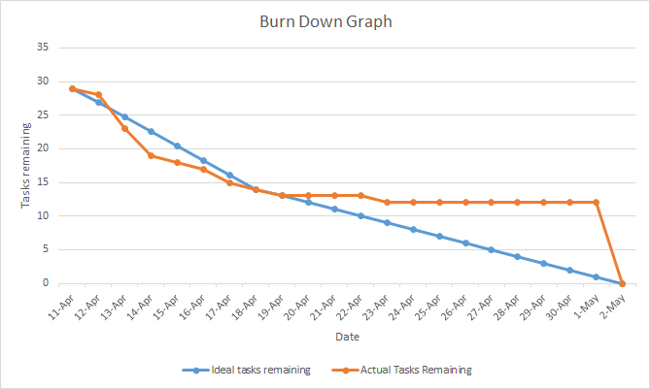
Burn Down Graph for Full Project

Slide 10
Conclusions
We ported our GUI-1 over to C# from Java and then implemented the desired changes determined necessary from the beta testers.

Slide 11
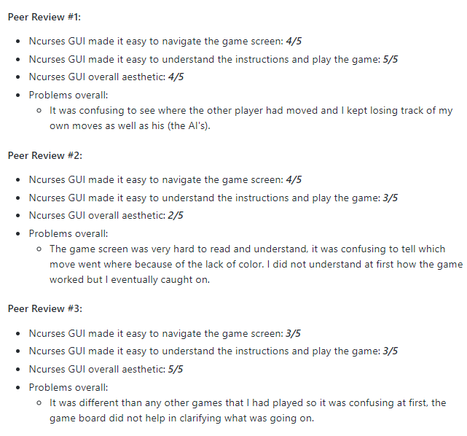
ncurses to GUI1 Peer Evaluations

Slide 12
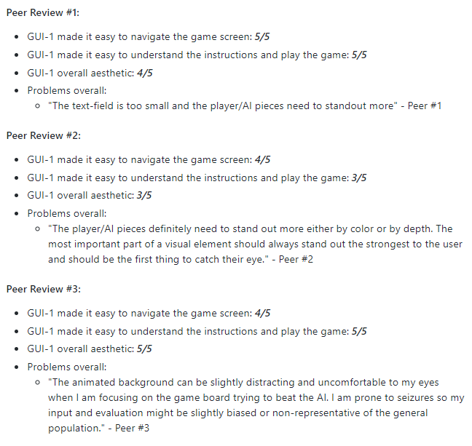
GUI1 to GUI2 Peer Evaluations

Slide 13
Future Improvements
Port over as an iOS app, using C#/Swift framework
Implement game board as a 3D model
Formatting for resizable windows
Multiplayer gameplay

Slide 14
How to Run the Game
Run the .exe/.jar file for the corresponding C# or java executable

Slide 15
References
Microsoft .NET Documentation
https://docs.microsoft.com/en-us/dotnet/index
Microsoft C# Guide
https://docs.microsoft.com/en-us/dotnet/csharp/

Slide 16
Questions?

